Slide 1

VA Online Scheduling Stakeholder Monthly Review
December 1, 2020

Slide 2
Agenda:
Meeting purpose
Backend updates
Front end updates
Stakeholder questions and discussion

Slide 3
Northstar Vision
Deliver a seamless and positive experience for
any Veteran who wants to schedule an appointment online.
Objective
Objective
Objective
Increase number of Veterans who are able to successfully request or schedule an appointment
Increase Veteran satisfaction with VA online scheduling experience
Decrease confusion in the online scheduling and appointment management process

Slide 4
VAOSR Product Principles
Veterans see appointments as a single experience. If the feature is not related to scheduling or canceling an appointment, it is a separate product.
Always give users a path forward. No dead ends.
Don’t use VA Online Scheduling to solve staff workflow problems.
Don’t ask VA Online Scheduling to solve bad data problems.
Don’t present Veterans with options they don’t have.
The burden of business rules is on us, not Veterans.

Slide 5
Purpose of the Monthly Stakeholder Demo + Roadmap & Backlog Review
Give the collective VAOS team a place to demo to all VAOS stakeholders what they have done in the past 2 sprints.
Give an overview of the roadmap for the next month, including what is in the backlog, how we are tracking against Program Increment (PI) goals.
Provide a space for stakeholders to discuss and ask questions about the roadmap/backlog, understand areas for escalation, and collectively agree on the direction forward for the next few weeks.

Slide 6
Goals of the Monthly Stakeholder Demo + Roadmap & Backlog Review
At the end of this meeting, participants:
Have seen the recent changes to the application’s front end, backend, and supporting services.
Understand the team’s priorities for the next sprint and how those priorities advance the program increment goals for this product.
Understand where specific user problems to be solved are in the backlog, as well as any related dependencies & blockers.

Slide 7
Stakeholder Expectations for the Monthly Demo + Roadmap & Backlog Review
Attend & be present. (Or, identify a representative on your team who can routinely attend). If you are representing a stakeholder, you have 2 main jobs in this meeting:
Take back applicable updates from this meeting to share with stakeholders/teams.
Follow up on decisions, outstanding questions, and action items assigned to you.

Slide 8
Backend (Apothesource team)

Slide 15
Front end (VA.gov) team

Slide 16
Agenda
Review tracking against PI objectives
Demo - PI #2 - Community care prototype + research
Review - PI #1 - Feedback/analytics for v2 of Facility Selection
Review - Veteran learning/affinity mapping session
Open items
Roadmap / Backlog

Slide 17
PI Objective Tracking
Released / Tracking Feedback
In progress
Discovery / Up Next
#1 - Decrease the veteran drop-off rate on the VA facility selection page to improve appointment request completion rate. |  | Released & responding to new feedback about v2 Facility selection Iterating to improve clarity on when/why VA Facility shows
#2 - Improving the Community Care experience so veterans choose from a list of available providers rather than free text. |  | 2 Research efforts complete - Synthesizing, will share insights & report MVP implementation in progress
#3 - Improve the usability of the VAOS/VA.gov home page to increase veteran satisfaction and adoption. |  | Using research from recent testing as input to next steps for homepage iteration
#4 - Want to develop analytics to track feature use to track where they're having difficulty with the tool. |  | Outreach to collect + establish metrics & KPI tracking across groups
#5 - Establish HSRM integration so that we can send community care requests directly to HSRM (no Front End) |  | Mike R. to offer latest in BE updates
#6 - Improve reliability and stability for VAOS to handle video visits and VistA appointments. |  | Mike R. to offer latest in BE updates FE tracking work as part of future use/integration

Slide 18
Prototype + Research
Community care provider selection
DEMO
Goal
Understand what will help a Veteran find a community care provider.
Method
Interview veterans and test a concept for selecting a community care provider.
We also tested potential improvements to the appointments list in anticipation of future discovery work.
Prototype test with 8 Veterans.
PI #2

Slide 19
Provider selection research
DEMO
Preliminary findings
Some takeaways from running a prototype test with 8 Veterans
Personalization, availability, and location were most important in selecting a provider
Veterans want to easily schedule appointments with providers they’ve seen in the past
The main value of selecting multiple providers; getting an appointment faster
Type of care was most important after date and location for identifying appointments
PI #2

Slide 20
Community care scheduler research
DEMO
Preliminary findings
Some takeaways from interviewing 7 community care schedulers:
Reliance on internal knowledge of, and good relationships with providers
Clinic name would be helpful in PPMS - schedulers often Google for more info
Some build extra processes to support the systems already in use (spreadsheets)
Subspecialties list continues to be problematic for Veterans to search
PI #2

Slide 21
Technical Discovery
High Level Technical Strategy Immediate term (MVP) Will continue to use the Lighthouse Facilities API integration with PPMS, pending some changes with some minor changes that are already underway. 1 . More direct interface to querying PPMS (Lat/Long and Radius)
2. Additional logging to assist in future iteration
3. Taxonomy mapping (business decision)
Medium term Iterate and share research findings with PPMS and Lighthouse. Long term (data source alternative)
Stand alone service for providers based off of data-dump from PPMS.
CC Provider Selection
Identified and strategized around key challenges
Identified short term goals for delivering milestones
Identified potential blockers
Identified medium term areas for iteration
Identified possible longer term alternative
PI #2

Slide 22
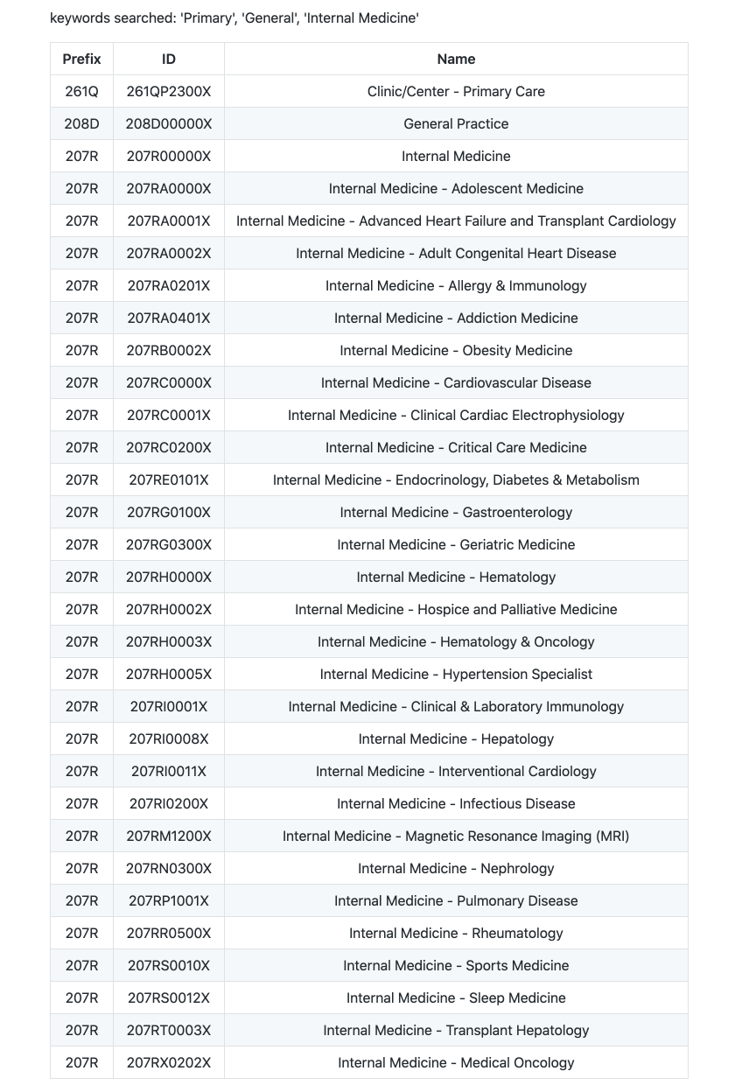
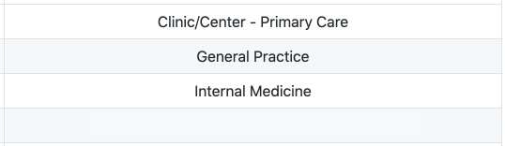
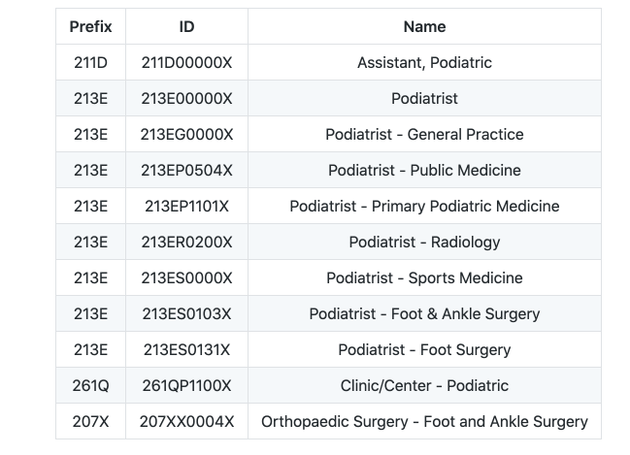
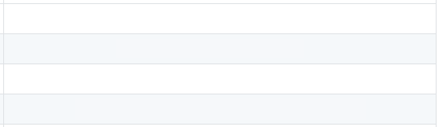
Primary Care
keywords searched: 'Primary', 'General', 'Internal Medicine'
Podiatry
keyword searched: 'foot', 'ankle', 'podiatr'
1
2
3
4
?
1
?
2
?
3
?
4
?

Slide 23
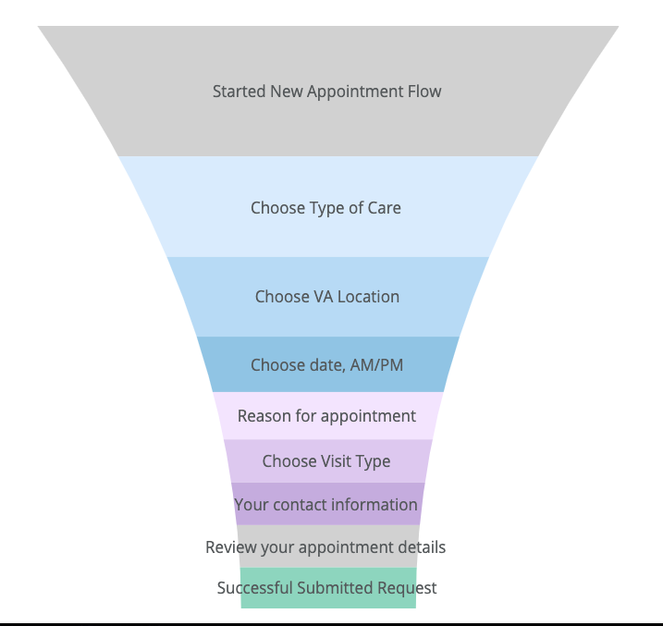
V2 Facility Selection Feedback
Criteria for what facilities are displayed to a Veteran:
Veteran is (or has been) registered to facility
Facility has online scheduling enabled (via VATS) for the type of care selected
Facility list shown to Veterans is sorted:
Based on home address listed in VA Profile on VA.gov
Current location (if Veteran chooses to use this feature)
Alphabetically if Veteran does not have home address in VA Profile
If facility Veteran is looking for does not have VAOS enabled (via VATS), that facility will not show to Veteran.
Focus next - improvement to properly set expectations for facility availability.
A/B test - 10/23 - 10/30 saw ~2% decrease in user drop off on this page
Comparison:
10/1 -10/16 vs. 11/1 - 11/16
~3.25% decrease in user drop off on this page
Continued feedback from Veterans “facility is not showing” OR..
Seeing facilities they haven’t been to for years
PI #1

Slide 24
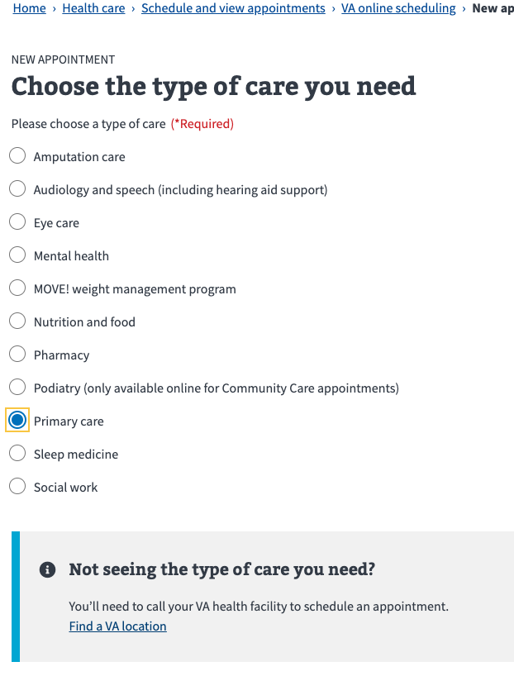
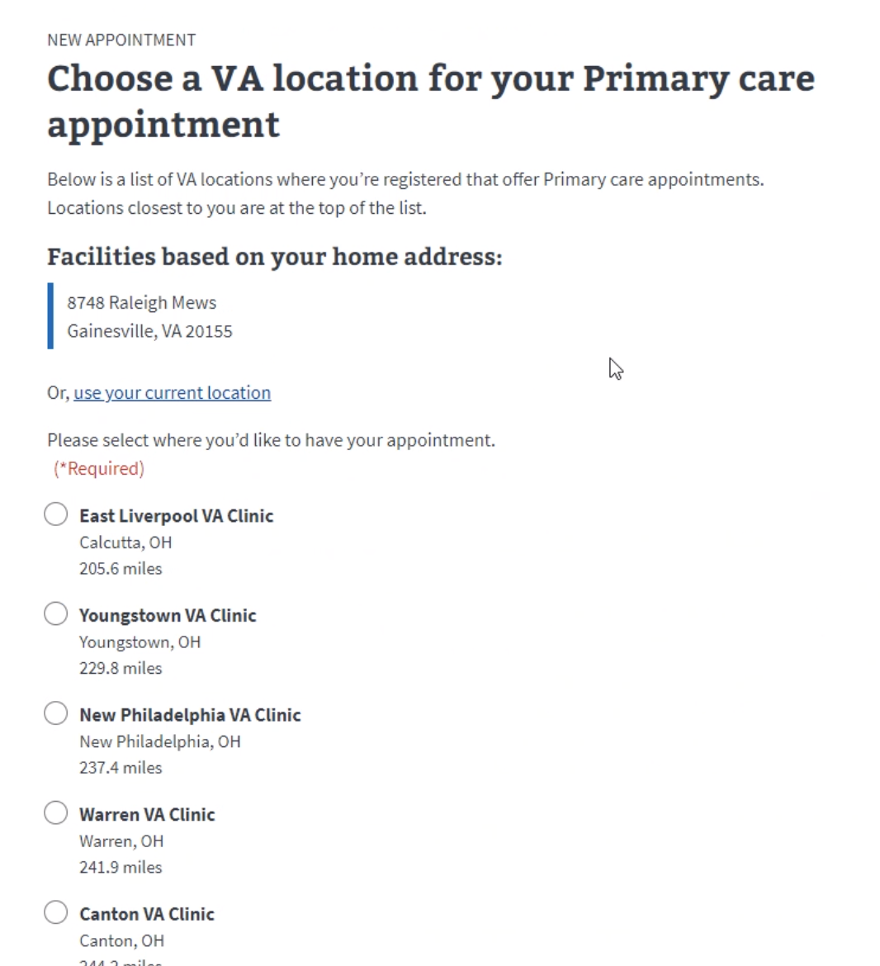
Veteran example of this...
What happened here?
Veteran wanted to schedule an appointment in VAOS for Primary Care at VAMC
Veteran expected to see DC VAMC in list
Veteran was returned options in Ohio
Veteran is registered in DC & Ohio
DC VAMC only has mental health enabled for online scheduling (all other care types turned off for VAOS)
Veteran would have considered CBOC closer to them in Virginia, but not registered so didn’t show

Slide 25
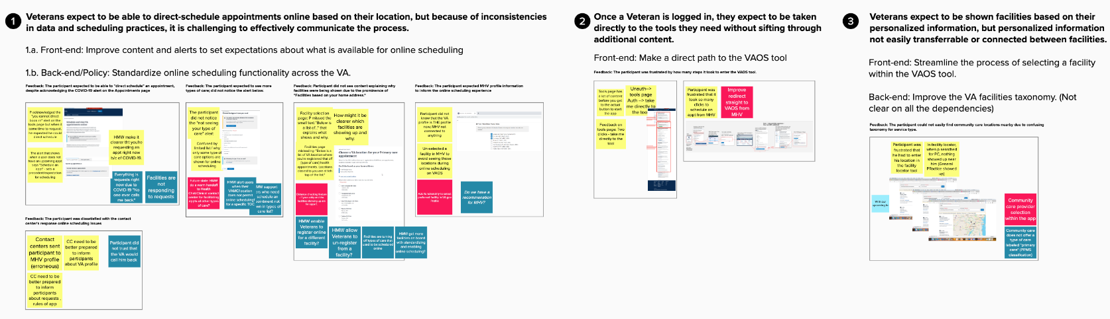
Veteran Affinity Mapping
Overall Key takeaway
(that is echoed in research that follows)
Veterans expect to be able to direct-schedule appointments online based on their location, but because of inconsistencies in scheduling practices,
it is challenging to effectively communicate what
is happening "under the hood."
Observed Issues
Recommendations
Veteran’s want to use VAOS to direct schedule appointments, not make requests for an appointment that still requires phone coordination
Confusion and frustration with limited list of types of care available for online scheduling
Inconsistencies of why some facilities show in VAOS and others don’t
Community care's data in PPMS is not aligned to VA's health taxonomy.
Troubleshooting direction provided from contact center to Veteran incorrect
“I do not trust VA to call me back”
VAOS application:
Clarity in app about care types & facilities
VA.gov working on adding functionality to the VA profile that would allows for “preferred” VAMC
PPMS taxonomy mapping + Community care provider selection in app
Improve direct path from MHV to VAOS
Re-enabling self schedule & standardizing online scheduling configurations across VAMCs
Resolving outstanding backlog of VAOS requests at VAMCs
Updating scripts & re-training Help Desk on VAOS
Notes:
Veteran’s start online scheduling process expecting to direct schedule an appointment online, but can currently only request an appointment. In words of Veteran, "VA frequently does not call you back."
Confusion and frustration with limited list of types of care available for online scheduling. And of that list, not every facility offers every type of care.
Some facility locations are shown for online scheduling, but not others. And if a Veteran has ever been to a VA facility, that facility will show up as an option when scheduling.
Community care's data in PPMS is not aligned to VA's health taxonomy. For example, VA uses the term "primary care" to mean "internal medicine, general practice, etc."; but when Veteran tried to search for a primary care community provider near him, none came up because none are classified as "primary care."
When calling to troubleshoot the scheduling problem, contact centers mistakenly referred Veteran to update his MHV profile. The MHV Profile is not connected to any of VA's systems and does not impact the scheduling process

Slide 26
Open Items
Tracking potential new initiative for VAOS supporting COVID vaccine distribution
Finalized mapping of 6 community care types to the 245+ PPMS Specialty Codes
Next steps on analytics
Collecting cross-stakeholder metrics & KPIs
Next steps on VSSC + Community care
MAS supporting telephone visit distinction vs. in-person -- in-progress by BE first
Appointments not showing: Continue to get this feedback. Is MHV still using a different way to show upcoming appointments?
Plans + Timing for Scheduling Manager replacement: Is there a final decision on using VSE as the intake for VA Appointment Requests and HSRM for CC requests?
Plans + Future of VATS
AI: Call with OVAC for Facilities

Slide 27
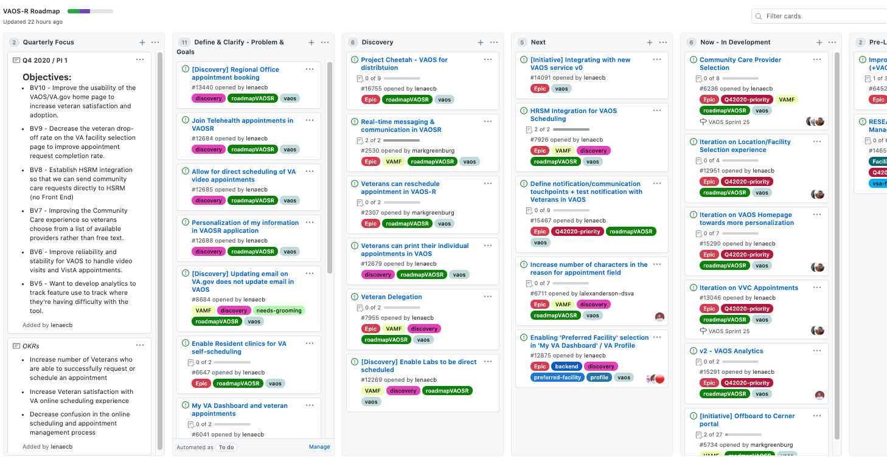
Roadmap
https://github.com/department-of-veterans-affairs/va.gov-team/projects/13

Slide 28
Stakeholder - Critical updates, action items, decisions, & questions

Slide 29
Action Items, Questions, & Decisions:
Open Action Item | DRI
Review HSRM documentation | Mike, Kim
Finalize mapping of 6 community care types to the 245+ PPMS Specialty Codes with Stakeholder input | Lauren E, Community Care team
Frontend call with OVAC – Facility selection | Lenae, Jennifer

Slide 30
Action Items, Questions, & Decisions:
VMR link to Clinic-to-Clinic visits?
Is MHV still using a different way to show upcoming appointments?
Is there a final decision on using VSE as the intake for VA Appointment Requests and HSRM for CC requests?

